Slide 1


The Movies Report
By Charlie Jin

Slide 2
Agenda
Factors to consider
Genres that produces the most money
What movies should studios continue to make to maximize profits
Ultimate goal
Find out what kind of movies to make and continue to make to earn money.
Evidence
Genres with the Highest Average Gross Table
(Slide 3)
Highest Grossing Movies of All Time Table
(Slide 4+5)
Most Expensive Movies of All Time Table
(Slide 6+7)
Net Gain Table = (Highest Grossing Movies – Most Expensive Movies)
(Slide 8-11)

Slide 4
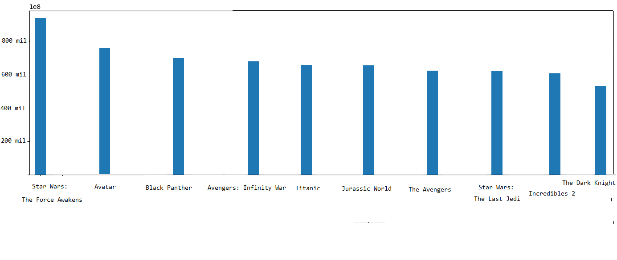

Ten Highest Grossing Movies of All Time Domestically

Slide 5
Ten Highest Grossing Movies of All Time Domestically
9 out of 10 are franchise movies
7 out of 10 were not the first films of a franchise
10 out of 10 are action, adventure, or animation
4 out of 10 are comic book movies
10 out of 10 are blockbusters

Slide 6
Most Expensive Movies of All Time
Now to explore the most expensive films of all time by production budget.
The table on the next slide is needed for later tables and discussion.

Slide 7
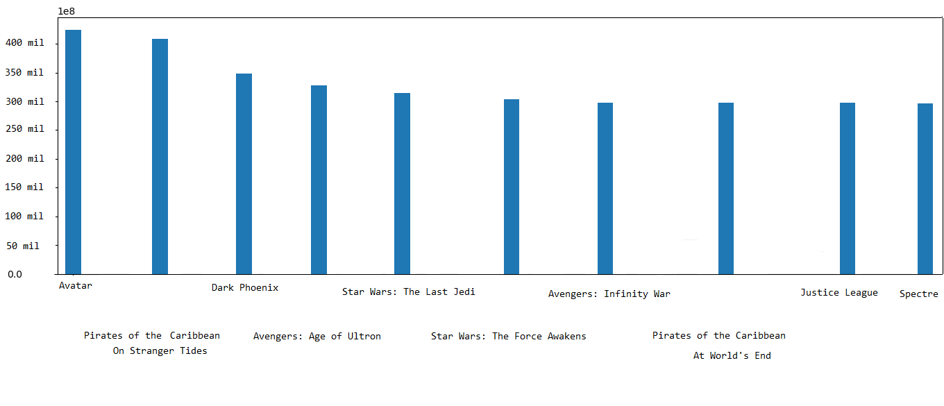
Most Expensive Movies of All Time

Slide 8
Most Profitable Movies of All Time
Movie Production Budget Worldwide Gross Net Gain
1. Avatar 425,000,000 2,776,345,279 2,351,345,279
2. Titanic 200,000,000 2,208,208,395 2,008,208,395
3. Avengers: Infinity War 300,000,000 2,048,134,200 1,748,134,200
4. Star Wars Ep. VII: The Force Awakens 306,000,000 2,053,311,220 1,747,311,220
5. Jurassic World 215,000,000 1,648,854,864 1,433,854,864
6. Furious 7 190,000,000 1,518,722,794 1,328,722,794
7. The Avengers 225,000,000 1,517,935,897 1,292,935,897
8. Harry Potter Deathly Hallows: Part II 125,000,000 1,341,693,157 1,216,693,157
9. Black Panther 200,000,000 1,348,258,224 1,148,258,224
10. Jurassic World: Fallen Kingdom 170,000,000 1,305,772,799 1,135,772,799

Slide 9
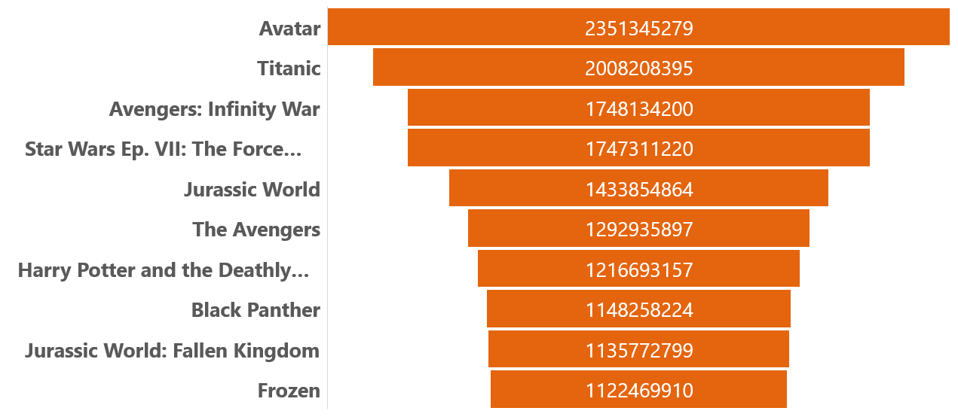
Net Gain Table Most Profitable Movies of All Time

Slide 10
Least Profitable Movies of All Time
Movie Production Budget Worldwide Gross Net Gain
1. Dark Phoenix 350,000,000 149,762,350 -200,237,650
2. Moonfall 150,000,000 0 -150,000,000
3. Mars Needs Moms 150,000,000 39,549,758 -110,450,242
4. Men in Black: International 110,000,000 3,100,000 -106,900,000
5. Town & Country 105,000,000 10,364,769 -94,635,231
6. The Adventures of Pluto Nash 100,000,000 7,094,995 -92,905,005
7. Bright 90,000,000 0 -90,000,000
8. Army of the Dead 90,000,000 0 -90,000,000
9. Call of the Wild 82,000,000 0 -82,000,000
10. The Promise 90,000,000 10,551,417 -79,448,583

Slide 11
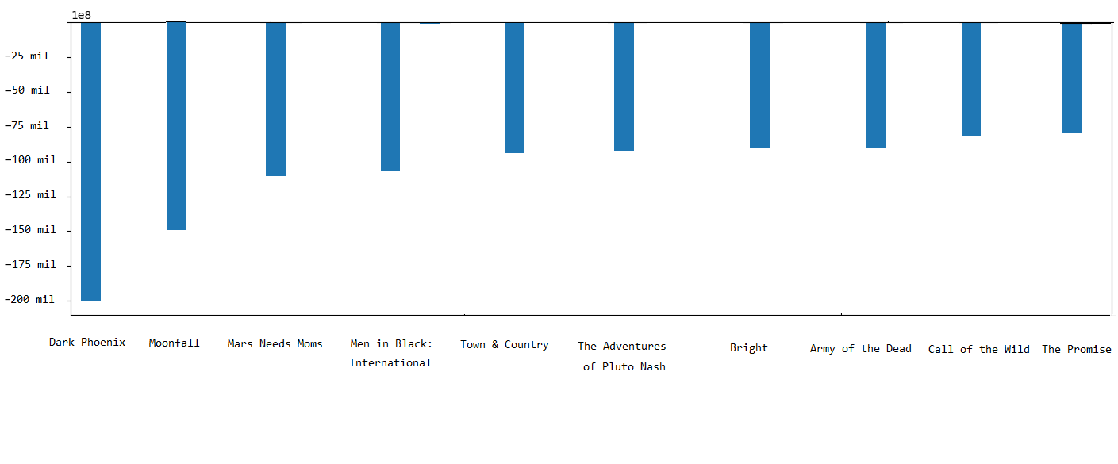
Net Gain Table Least Profitable Movies of All Time

Slide 12
Dark Phoenix The ultimate bomb
An X-Men movie specifically about Jean Grey, released in 2019.
22% rottentomates. 43% metacritic.
A huge business loss. Lost about 200 million dollars.
Why? Bad reviews. Oversaturation of comic book movies. Some of the reasons.

Slide 13
Recommendation
More franchise films, especially if the first film was very successful.
More action, adventure, animation, family, blockbuster, comic book movies – the proven genres.
Greater chance of success with more proven filmmakers…. James Cameron, George Lucas.

Slide 14
Conclusion What decisions should studios make?
Action, adventure, and animation are the safest decisions to make.
Franchise movies is another proven movie maker.
Nearly all the money a studio makes are on big blockbusters products.

